Slide 1
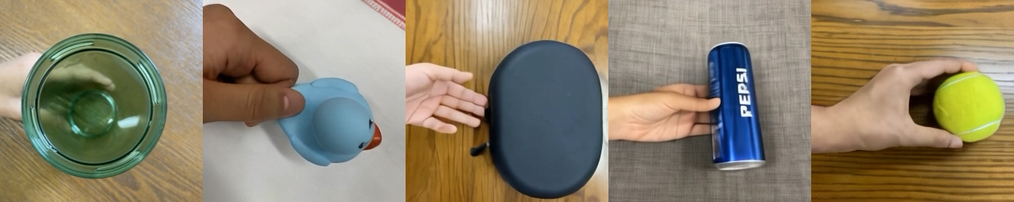
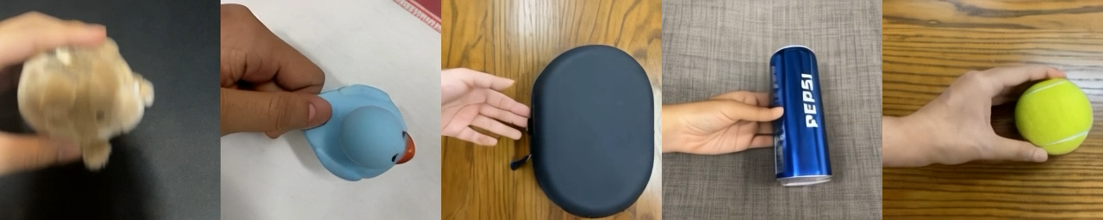
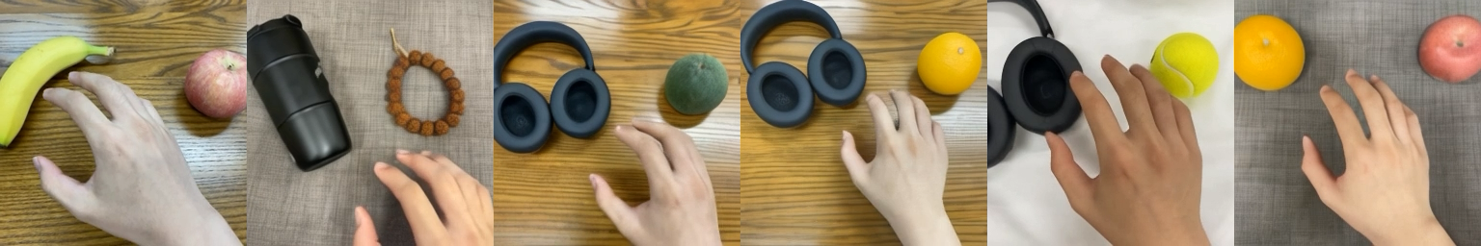
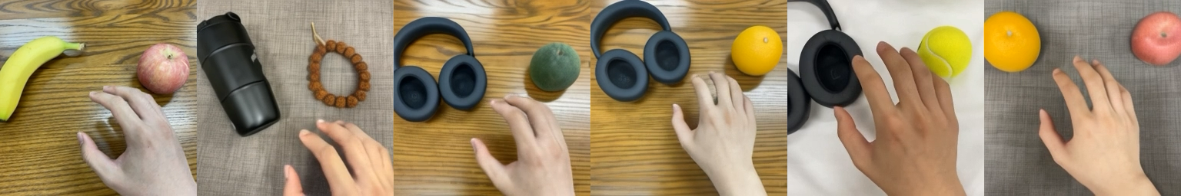
I-G pair (move left)
I-G pair (move down)
I-G pair (pick left)
I-G pair (pick right)

Slide 2
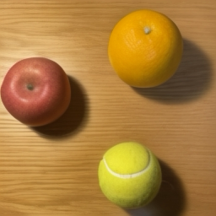





+latent action (a)
+latent action (c)
+latent action (e)
Initial Frame
+latent action (b)
+latent action (d)
+latent action (f)

Slide 3
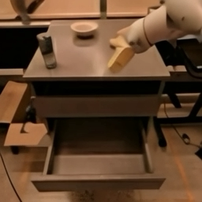
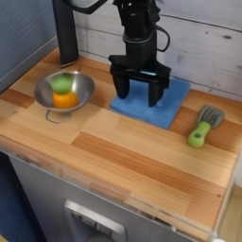


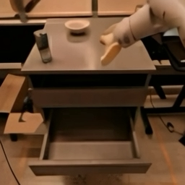

“Put the redbull into drawer”
“Slide the blue rag”
Initial Frame
“Close middle drawer”
Initial Frame
“Pick up the orange fruit”
“Open top drawer”
“Pick up the green spoon”

